Slide 1

A Curse of a White Elephant
Richard Esplin, Alfresco

Slide 2

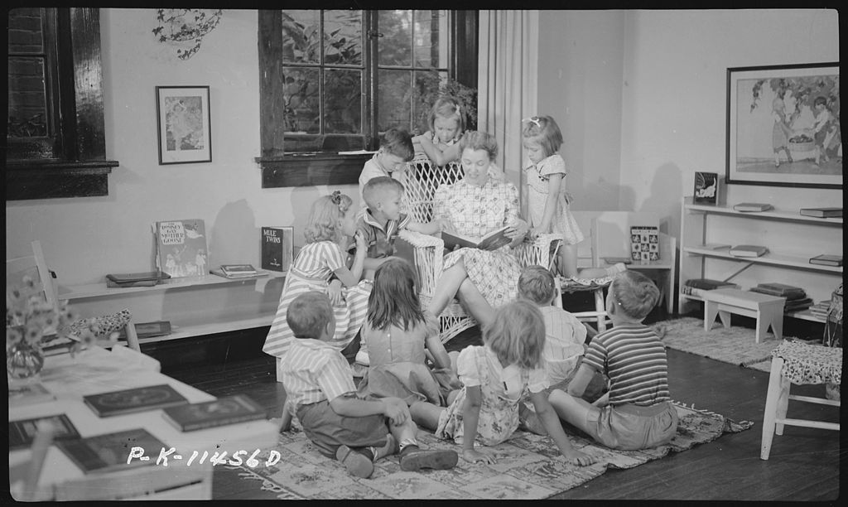

Slide 3
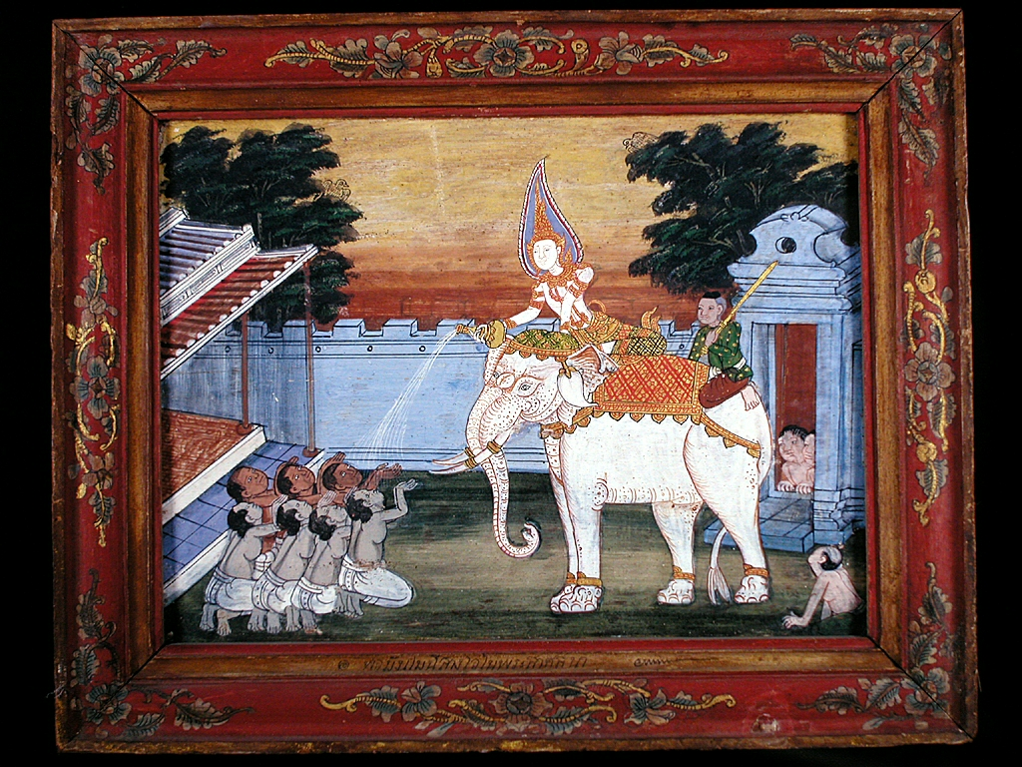

Slide 5

It is an honor to receive an open source contribution

Slide 6
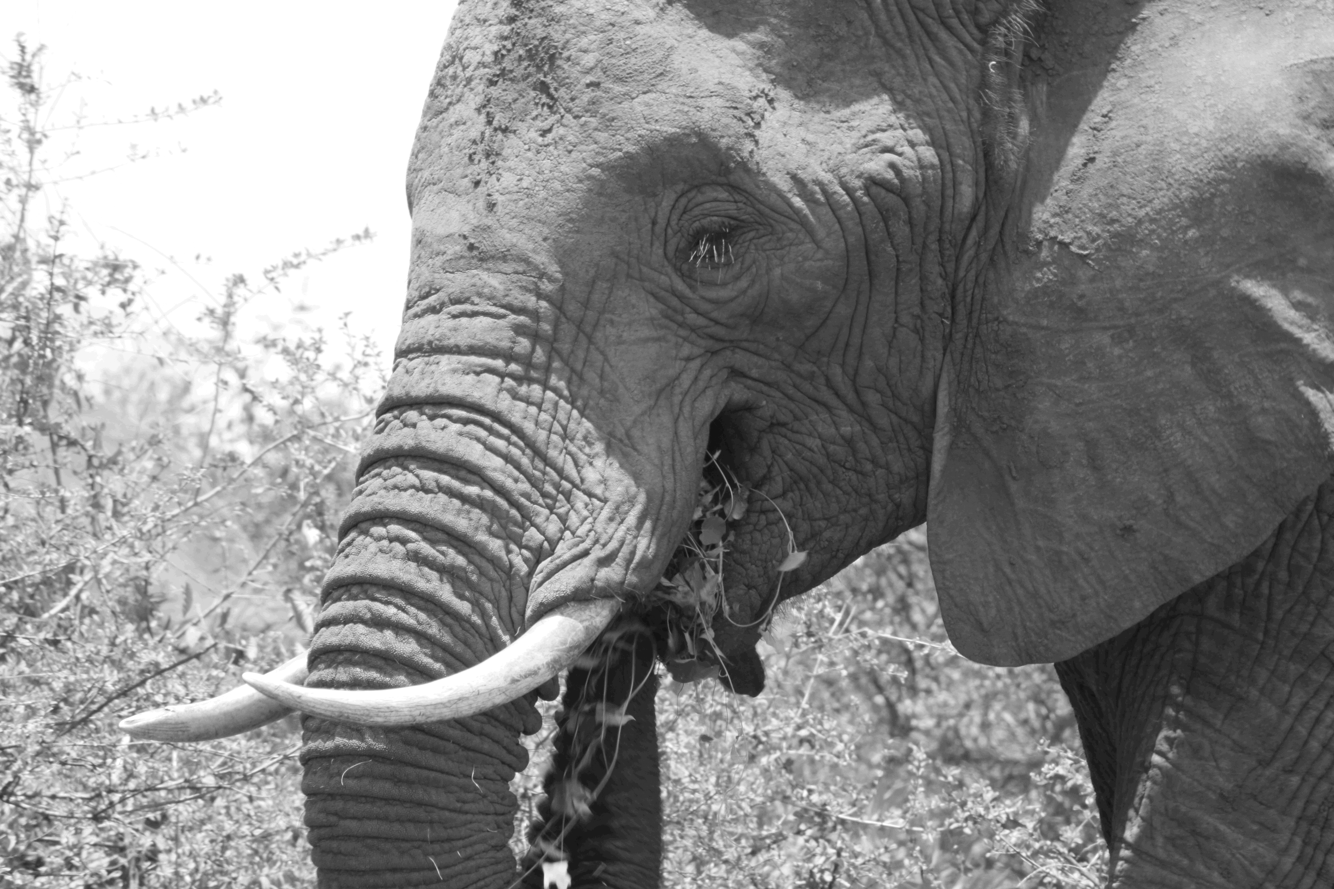
But it comes with a cost attached

Slide 7

Accepting a contribution creates a commitment

Slide 8
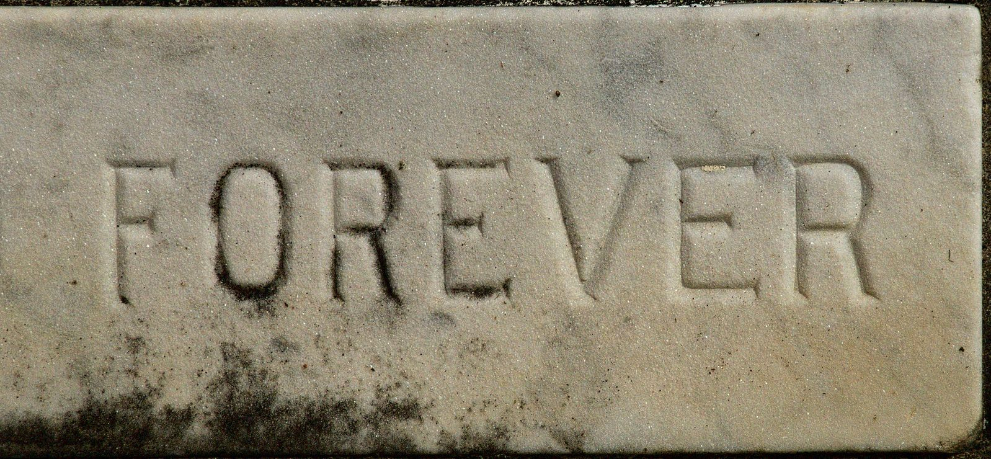
What could be a very long commitment . . .

Slide 9
Triage and Review

Slide 10
Vision and Roadmap

Slide 11
Opportunity Cost

Slide 12
Architectural Evolution

Slide 13
Polish

Slide 14
Documentation

Slide 15
Training
(internal and external)

Slide 16
Support and Mainenance

Slide 17
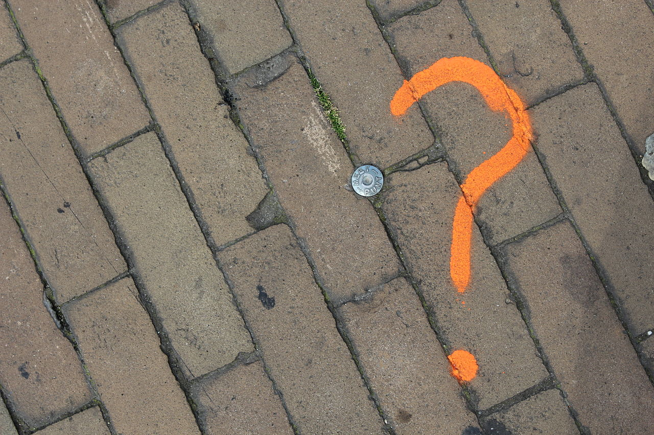
What is my point?

Slide 18

Polite Disagreements
Image credit: https://www.flickr.com/photos/soukup/5157560198

Slide 19

We need to lower the cost of contributions

Slide 20
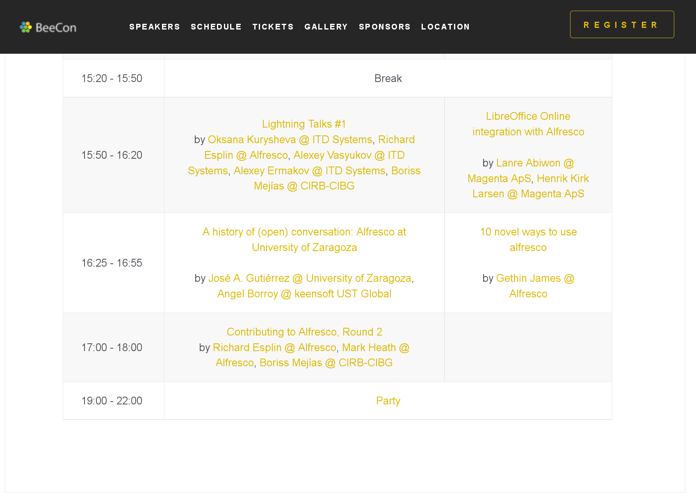
Context

Slide 21
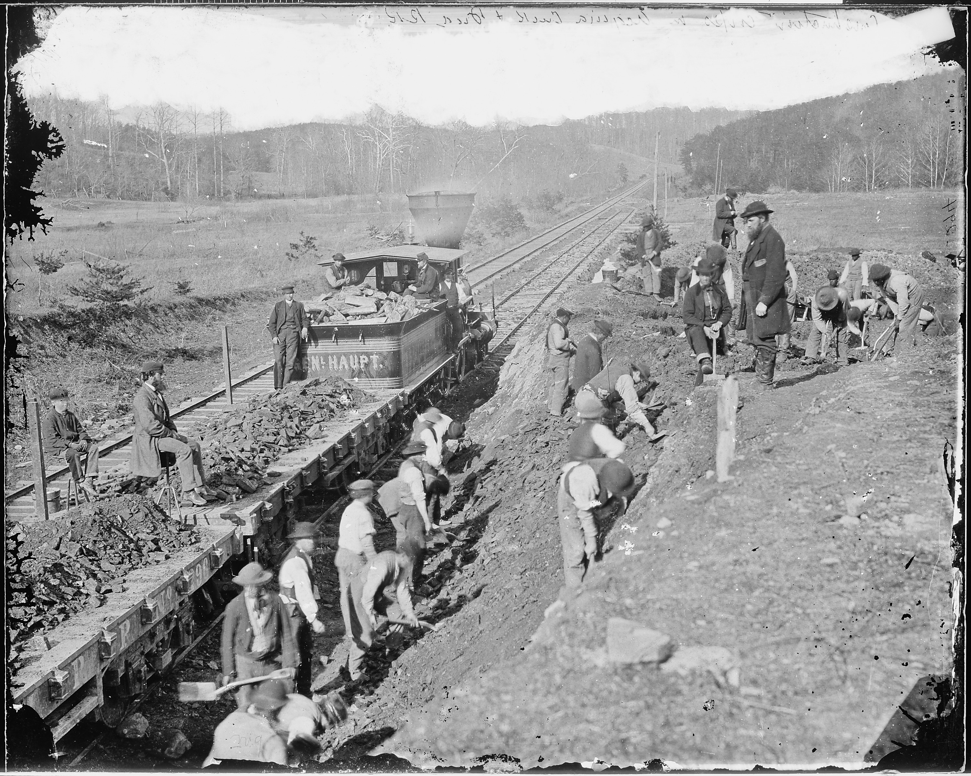
Empathy

Slide 22
Continue the conversation:
http://community.alfresco.com

